Slide 1
Title – Delivery Project
By
Pranit Pisal

Slide 2

Objective
To predict the Delivery time using Sorting time

Slide 3

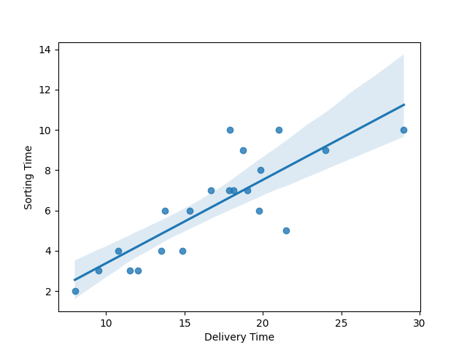
Solution
Doing EDA on current dataset.
Using Linear regression over the current data.
Analysing the insights and Graph patterns.

Slide 4
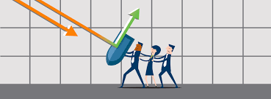

Business Impact
This will help in predicting the delivery time based upon the sorting time.
This will result in helping our customers to inform about their package delivery within seconds.

